Slide 1
2016 Assessment of College Processes
Spring 2016

Slide 2
Background
Accreditation Recommendations
Integrated Planning and Budgeting Cycle – ‘closing the loop’
Questions/criteria developed from:
  2011 College-wide assessment
  CEMPC input
  ACCJC effectiveness criteria

Slide 3
Overview
Online survey: survey monkey
Ordinal and interval Likert scale questions, open ended questions
5 major sections
  Assessment
  Program Review
  Integrated Planning and Budgeting
  Collegial Decision-Making
  Participatory Governance Committees (College Council, CEMPC, CBC, CTC, CFC)
82 Responses collected: 6 Administrators, 23 Classified Staff and 53 Faculty

Slide 4
Summary Comments
The campus recognizes wide-scale efforts at improvement, which makes constituents feel like the campus is improving in effectiveness.
It is imperative that in order for these processes to improve, more of the campus needs to be involved and aware.
Campus processes overall face similar challenges: to increase participation and collaboration, transparency, simply and sustain.
The campus needs to define what effectiveness looks like for all these processes and identify potential direct measures of assessment.

Slide 5
Results - Assessment
Assessment Processes | Always/Most of the Time |  | Occasionally/Some of the Time |  | Rarely/Never |  | I don’t know.
My department or unit plans and prepares for upcoming assessment activities. | 38 | 46% | 33 | 40% | 7 | 9% | 4 | 5%
My department or unit makes improvements based on assessment results. | 39 | 48% | 20 | 25% | 14 | 17% | 8 | 10%
Overall, assessment drives improvement in student learning and achievement at Merritt College. | 26 | 32% | 37 | 46% | 11 | 14% | 7 | 9%
Please rate the effectiveness of assessment processes (SLO, PLO, and ILO) at Merritt College. | Average: 5.81

Slide 6
Results – Program Review
Program Review Process | Always/Most of the Time |  | Occasionally/Some of the Time |  | Rarely/Never |  | I don’t know.
Program Review is data-driven and includes analysis of institutional and learning outcome assessment data. | 32 | 42% | 24 | 31% | 7 | 9% | 14 | 18%
My department or unit makes improvements based on results of program review. | 28 | 36% | 29 | 38% | 11 | 14% | 9 | 12%
My department or unit requests new resources based on results of program review. | 36 | 47% | 21 | 28% | 8 | 11% | 11 | 15%
Overall, program review drives improvement in student learning and achievement at Merritt College. | 27 | 35% | 22 | 29% | 13 | 17% | 15 | 20%
Please rate the effectiveness of the Program Review process at Merritt College. | 5.61

Slide 7
Results Integrated Planning and Budgeting
Integrated Planning and Budgeting Process | Always/Most of the Time |  | Occasionally/Some of the Time |  | Rarely/Never |  | I don’t know.
Budget development and resource allocation is driven by planning and assessment. | 19 | 25% | 23 | 31% | 15 | 20% | 18 | 24%
Resources requests are linked to data and institutional goals. | 20 | 27% | 26 | 35% | 12 | 16% | 17 | 23%
Overall, integrated planning and budgeting results in improvement of student learning and achievement at Merritt College. | 15 | 20% | 23 | 31% | 17 | 23% | 20 | 27%
Please rate the effectiveness of the integrated planning and budgeting process at Merritt College. | Average: 4.94

Slide 8
Results – Collegial Decision Making
Collegial Decision Making | Always/Most of the Time |  | Occasionally/Some of the Time |  | Rarely/Never |  | I don’t know.
Governance committees represent all constituency groups in decision making processes. | 15 | 21% | 36 | 50% | 8 | 11% | 13 | 18%
Governance committees collaborate to implement data driven and integrated planning and budgeting processes. | 12 | 17% | 30 | 42% | 16 | 22% | 14 | 19%
Governance committees engage in dialogue about institutional effectiveness. | 19 | 27% | 32 | 45% | 9 | 13% | 11 | 15%
Overall, decision making through Participatory Governance at Merritt College results in improved student learning and achievement. | 11 | 15% | 29 | 40% | 18 | 25% | 14 | 19%
Please rate the effectiveness of the collegial decision making process at Merritt College. | Average: 4.76

Slide 9
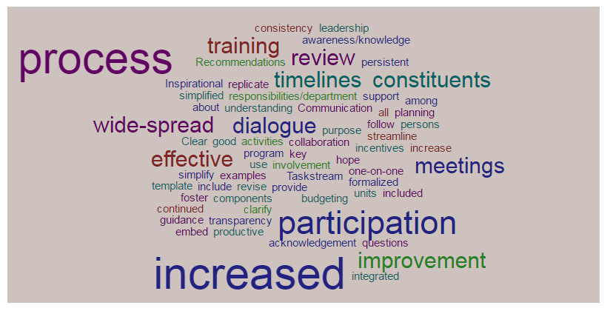
Making Improvements – Group Activity

